Slide 1
WELCOME!

Slide 2
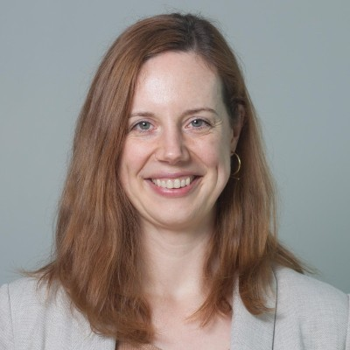
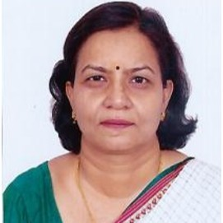
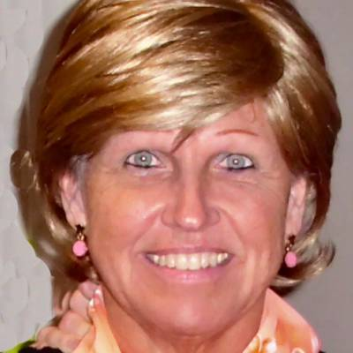
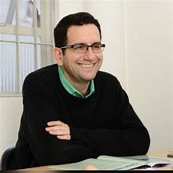
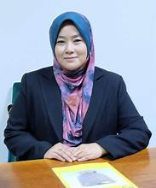
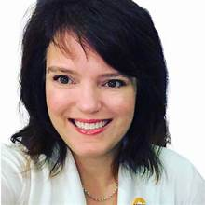
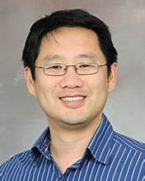
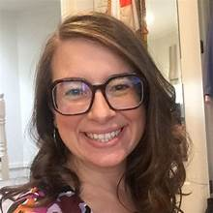
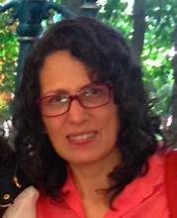
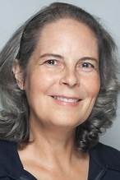
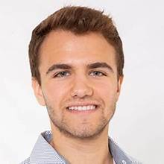
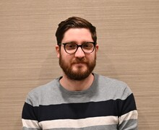
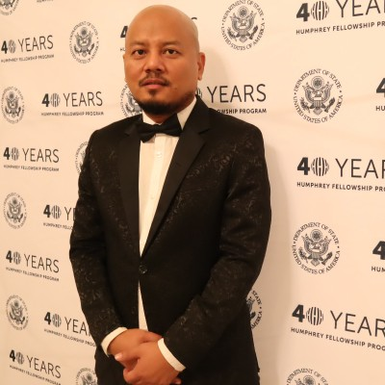
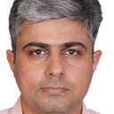
CPDD’s International Committee
Laura Brandt (Germany/ Austria/ USA)
Raka Jain (India)
Dace Svikis
(USA)
Thiago Fidalgo (Brazil)
Suzaily Wahab (Malaysia)
Erin Winstanley (USA)
Jin Yoon
(USA)
Kathryn Biernacki (Australia)
Silvia Cruz
(Mexico)
Diana
Martinez
(USA)
Alex Guerin (Australia)
Lalchhanhima
Ralte (India)
Yatan Pal Singh Balhara (India)
Thomas Santo
(Australia)

Slide 3
Our first day at Kindergarten CPDD Experiences

Slide 4
Financial Support/Discount Options
Membership fees are waived for certain World Bank Country classifications – member needs to reach out to the Executive Office at info@cpdd.org
At this time the process to waive fees is not an automated option
Meeting Registration waived or significantly discounted for certain World Bank Country classifications – registration rates are programmed based on home country
Over 80 Travel Awards are awarded by CPDD each year
Some specifically serve international and underrepresented populations

Slide 5
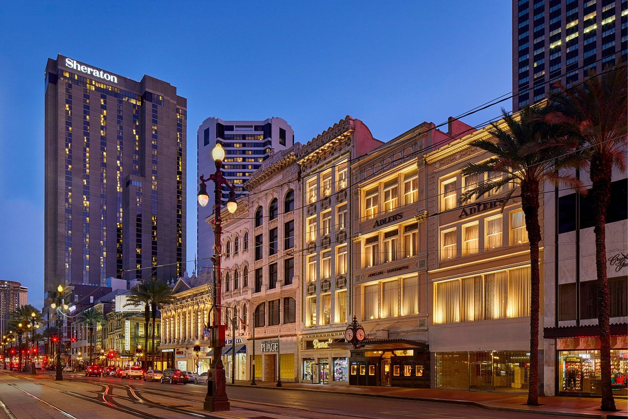
Your Visit to New Orleans, LA
https://cpdd.societyconference.com/v2/
→ Visiting New Orleans

Slide 6
Visa Letter
Attendees who require a visa to enter the US should email info@cpdd.org to request a personalized letter of invitation
Please use the Visa Wizard to find out what visa type is appropriate for you.
CPDD will issue a letter of invitation to support a visa application upon request. To receive a letter of invitation, you must be either:
a CPDD member in good standing;
an author or presenter listed on a scientific submission for the meeting; or
a registered attendee.
This is the full extent of assistance CPDD will provide with the visa application process

Slide 7
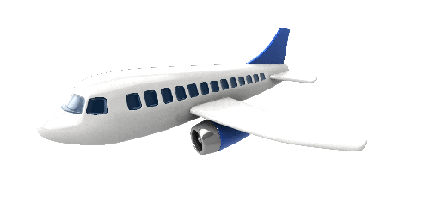
Travel by Air
https://cpdd.societyconference.com/v2/
→ Visiting New Orleans
Louis Armstrong New Orleans International Airport (MSY) is the closest airport
Delta Airlines offers a special discount when you book here

Slide 8
Conference Housing
Meeting will take place at the Sheraton New Orleans
Discounted guest rooms at the hotel with a discounted rate of $239.00 US, plus applicable taxes: https://book.passkey.com/event/50867100/owner/111/home
Discounted room rates are available until 5 pm local time on Thursday, May 22, 2025, or until the block is full.

Slide 9
Conference Housing
Find others who are looking to share a room!
To help defray the cost of conference housing, CPDD has created a self-serve Room Sharing Program
This online tool is available until May 30, 2025

Slide 10
Join us at CPDD!
@ our International Workshop “Building Capacity for International Research: Overcoming Barriers in Resource-Constrained Settings and Fostering Collaboration”
@ our International Networking Zone
We will hold a drawing for a complimentary 2026 CPDD meeting registration!
Exact date and time to be announced – keep on the lookout for the official CPDD program!
NIDA International participants will be able to attend all Saturday & Sunday meeting sessions at no additional cost!

Slide 11
Current IC Initiatives
A growing data base listing international funding opportunities: https://parthenonmgmt-my.sharepoint.com/:x:/p/jhoward/EXNtZIITnGdBqPivqkzUvy8B5W6XppDg-GKRZUBigOY72w?rtime=aOwJ4i8S3Eg
If you know of any opportunity that supports international mobility for researchers, please add it to our library!
A Special Issues of the CPDD Newsline will highlight International Research
Let us know if you’d like to be included!

Slide 12
Questions?
Please do not hesitate to reach out with any questions!
info@cpdd.org
lbrandt@ccny.cuny.org

Slide 13
We hope to see you in-person soon!

